Slide 1
Politically relevant Census Data

Slide 2
Objectives
Target end user
End user needs
Flexibility / adjustability
Simplicity
consistancy
Pupulation
Education
Poverty
employment
Industry
Citizenship
Ethnic mix

Slide 3
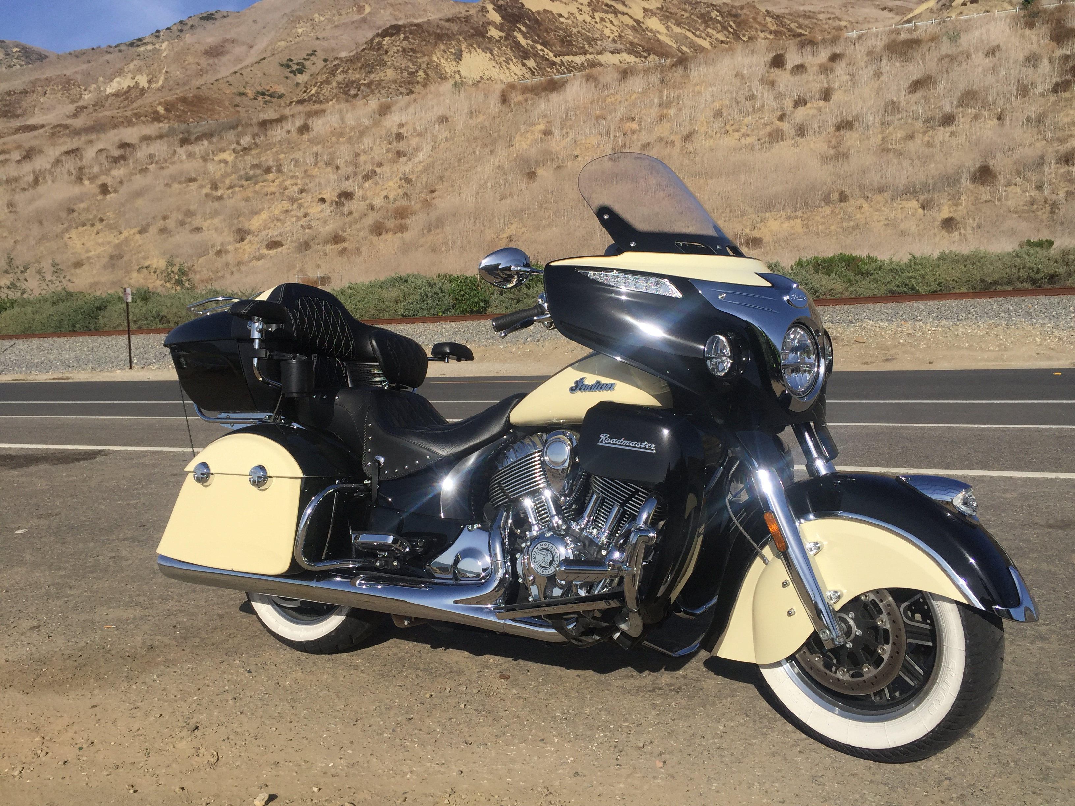
Collecting Data
Comments on census bureau APIx
X
X
X
X
X
X
X

Slide 4
Cleaning Code
Combining data sets
Picture – comments on variables
X
X
X
X
X
X

Slide 5
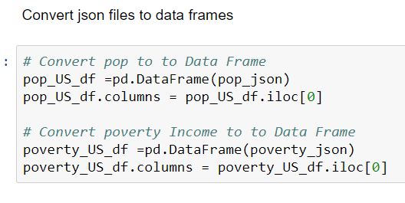

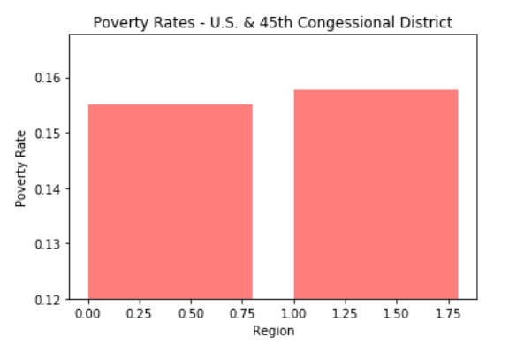
Graph #1 - Population
Population Graph
Population code

Slide 6
Graph #2 - Education
Education Graph
Education code

Slide 7
Graph #3 - Employment
Employment Graph
Employment code

Slide 8
Graph #4 - Poverty levels
Poverty Graph
Poverty code

Slide 9
Graph #5 - Poverty levels
Poverty Graph
Poverty code

Slide 10
Graph #6 - Industry
Industry
Industry

Slide 11

conclusions
Objectives met
-X
X
X
X

